Slide 1

Money Honey Financial Services Pvt. Ltd.
HYBRID MUTUAL FUNDS

Slide 2
AGENDA
Introduction
What Are Hybrid Mutual Fund
How does it works?
Who should invest in Hybrid funds?

Slide 3
1. INTRODUCTION

Slide 4


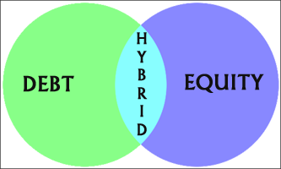


INTRODUCTION:

Slide 5
2. WHAT ARE HYBRID MUTUAL FUNDS

Slide 6

WHAT ARE HYBRID MUTUAL FUNDS
These are mutual fund schemes which invest in more than one asset class i.e. equity, debt and other
It is also known as an Asset Allocation Fund
Each hybrid fund has a different combination of equity and debt targeted at different types of investors.
Aim to diversify the portfolio to minimise the risk involved.
Potential to generate relatively better returns than debt funds & less risky than equity funds.

Slide 7



Slide 8
3. HOW DOES IT WORKS

Slide 9




HOW DOES IT WORKS?
Fund manager creates a portfolio according to investment objective of the scheme.
Allocates the funds in Equity & Debt instruments in varying proportions.
The fund manager also buys or sells assets if the market movements are favorable.

Slide 10



Slide 11
4. WHO SHOULD INVEST IN HYBRID FUND

Slide 12

WHO SHOULD INVEST IN HYBRID FUND
Hybrid funds are considered to be riskier than debt funds but safer than Equity funds.
They tend to offer better returns than debt funds.
Mostly preferred by many low-risk investors.
New investors who are unsure about stepping into the equity markets tend to turn towards hybrid funds.
Hybrid funds allow investors to make the most out of equity investments while cushioning themselves against extreme volatility in the market.

Slide 13

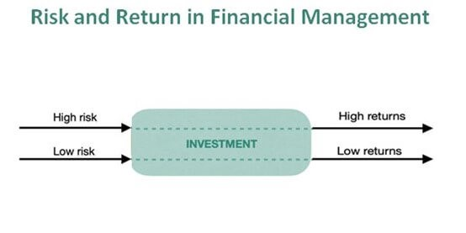


Slide 14
5.ADVANTAGES OF HYBRID FUND

Slide 15
ADVANTAGES OF HYBRID FUND
HELP IN ACCESSING MULTIPLE ASSET CATEGORIES VIA A SINGLE FUND
THEY USE PORTFOLIO DIVERSIFICATION AND ASSET ALLOCATION
CATER RISK WITH OPTIONS FOR CONSERVATIVE, MODERATE, AND AGGRESSIVE INVESTORS.
PREFERRED FOR FIRST TIME INVESTORS & RETIREES
LTCG IS TAXED @10% OVER RS.1 LAKH & STCG IS TAXED @ 20%
LOW EXPENSE RATIO
LESS VOLTILE

Slide 16


Slide 17
2. TAX SLABS

Slide 18
TAX SLABS
For Residential Individual below 60 Years of Age)
For Residential Individual below 60-80 Years of Age)

Slide 19

TAX SLABS… (Tax Rebate U/S 87A)
Mr. Ajay: Miss Pooja, did you know you can claim a tax rebate if your taxable income does not exceed Rs 5,00,000.
Ms Pooja: What is a tax rebate?
Mr. Ajay: Tax rebate refers to the relief you can claim to reduce income tax burden. It refers to the amount of tax liability that you, as a taxpayer, do not have to pay.
Mr. Ajay: According to income tax act if your taxable income is Rs 5,00,000 or less than Rs 5,00,000 then you are eligible for a maximum tax rebate of Rs 12,500 under section 87A.
Mr. Ajay: ELSS can be one of the option to invest surplus income (income more than Rs 5,00,000) to make your taxable income less than Rs. 5,00,000 to avail the benefit of tax rebate.

Slide 20
TAX SLABS… (Tax Rebate U/S 87A)
Mr. Ajay: Let me give you a simple example:
Let’s say, if your total income is Rs. 6.50 Lakhs and if you invest in ELSS scheme, then you’re total taxable income becomes Rs. 5.00 Lakhs and you don’t have to pay any tax.
If you don’t invest in ELSS then taxable income remains as Rs. 6.50 Lakhs and you have to income tax of Rs. 31,200.
The tax rebate is limited to Rs 12,500 u/s 87 A . This means, if your total tax payable is less than Rs 12,500, then you will not have to pay any tax or you will get rebate of the amount payable.
It should be noted that the taxable income should not exceed Rs 5,00,000.Even if the income increases a minimal amount the person will not be eligible for the rebate.

Slide 21
TAX SLABS… (Tax Rebate U/S 87A)

Slide 22


Slide 23
3. Sec 80C Benefits

Slide 24
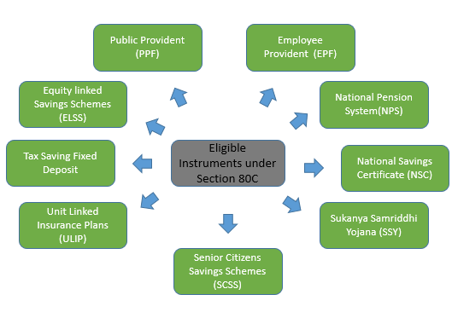
SECTION 80C BENEFITS
SEC 80C….THE LEGAL WAY OF NOT PAYING TAXES

Slide 25
SECTION 80C BENEFITS
Mr. Ajay: Section 80C allows certain deductions that helps to reduce tax burden on your total annual income.
Miss Pooja : Okay, how much deduction can I get through it?
Mr. Ajay: The maximum amount of deduction that can be claimed under section 80C is Rs. 1.50 lakh for the current financial year.
Reduce Your Taxable Income by
Rs. 1.50 Lakhs

Slide 26
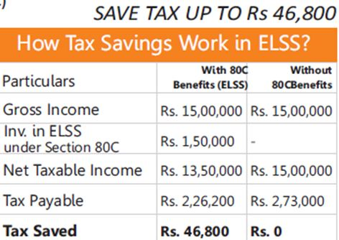
SECTION 80C BENEFITS
Mr. Ajay: Let me give you a simple example:
Let’s say, if your total income is Rs. 15 Lakhs and if you invest in ELSS scheme, then you’re total taxable income becomes Rs. 13.50 Lakhs.
If you don’t invest in ELSS then taxable income remains as Rs. 15 Lakhs.
Save Rs. 46,800 + Earn Returns on ELSS.

Slide 27


Slide 28
SECTION 80C BENEFITS…(How much tax can I save?)
Gross Income: Rs. 15 Lakhs
ELSS
Tax Savings: Rs. 46,800

Slide 29
SECTION 80C BENEFITS…(How much tax can I save?)
Gross Income: Rs. 10 Lakhs
ELSS
Tax Savings: Rs. 31,200

Slide 30
SECTION 80C BENEFITS…(How much tax can I save?)
Gross Income: Rs. 6.50 Lakhs
ELSS
Tax Savings: Rs. 44,200

Slide 31
Tax savings when gross income is less than Rs 5,00,000.
When your gross income is less than Rs 5,00,000 or Rs 5,00,000.
You get up to Rs 12,500 as rebate..
ELSS in this case can be used for wealth creation only.

Slide 32
4. LONG TERM CAPITAL GAINS (LTCG)

Slide 33
Taxes on Return
Holding Period
< 1 Years
>= 1 Years
Profit or Loss?
Profit or Loss?
Profit
Loss
Profit
Loss
Short Term Capital Gains (STCG) Tax
No Tax Required
Long Term Capital Gains (LTCG) Tax
No Tax Required
Since, holding period of ELSS is minimum 3 Years. There won’t be any Short Term Capital Gains (STCG) Tax.

Slide 34

LTCG ON ELSS
Ms Pooja: So are my returns on ELSS taxable?
Mr Ajay: Yes they are taxable when your returns exceeds Rs 1 lakh under section 112 A.
Ms Pooja : So is it a matter of worry?
Mr Ajay: You need not worry. ELSS, despite the burden of tax on LTCG. It is still one of the best wealth accumulator in the long run.
Long term capital gain below Rs 1 lakh is not taxable.
Long term capital gain above Rs 1 lakh is taxable @10% pa .

Slide 35
5. SIP OR LUMPSUM

Slide 36
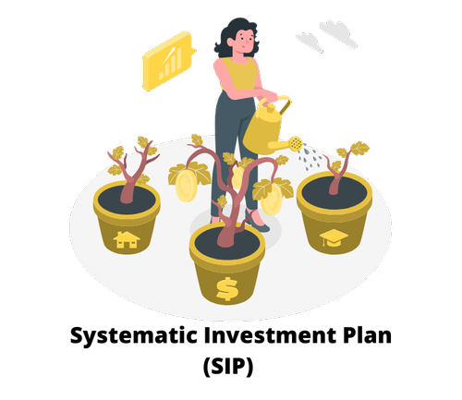
SIP in ELSS
Mr. Ajay: Systematic Investment Plan (SIP), more popularly known as SIP, is a facility offered by mutual funds to the investors to invest in a disciplined manner.
It is similar to a recurring deposit.
It is also convenient as you can give your bank standing instructions to debit the amount on specific time interval.

Slide 37

SIP in ELSS
Ms Pooja: What are the time intervals available to invest through SIP?
Mr. Ajay:
Monthly SIP
Weekly SIP
Daily SIPs
Quarterly SIP
Half-Yearly SIP

Slide 38
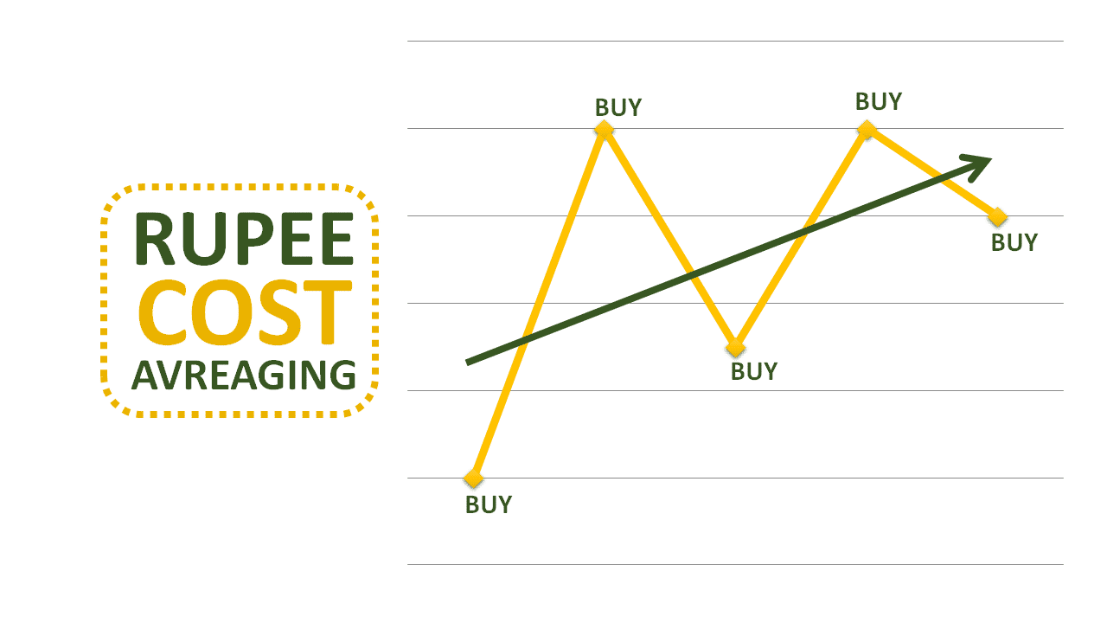
SIP in ELSS…(Rupee Cost Averaging)
Ms Pooja: What is rupee cost averaging?
Mr. Ajay: The concept of rupee cost averaging can be explained as:
Averaging out the cost at which you buy the mutual fund.
In simple terms you buy more units when the market is down and less units when the market is high.
An SIP is an easy way of doing this due to the benefit of rupee cost averaging.

Slide 39
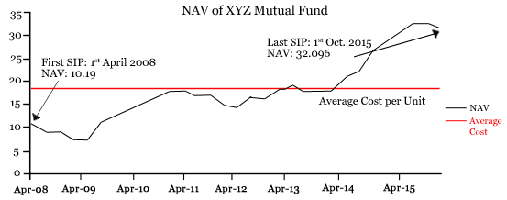
SIP in ELSS…(Rupee Cost Averaging)

Slide 40
SIP in ELSS…(Rupee Cost Averaging)
Investment via SIPs in mutual funds will allow you to take advantage of rupee-cost averaging in an automated manner. Take a look at the following table to understand this concept better
Total Investment: Rs 24,000
Total number of units bought: 637.32
Range of price per unit: Rs 28 – Rs 50
Average price per unit: Rs 37.67

Slide 41
SIP in ELSS…(Benefits of SIP)
Power of Compounding
Lowers the Risk of Market Fluctuation
Investment in ELSS becomes Hugely affordable with SIP
Beneficial for New Investors and Salaried Income Individuals
Rupee Cost Averaging: More units are purchased when market is low and less units are purchased when is high
Simplified Investment Process

Slide 42


Slide 43

LUMP-SUM Investment in ELSS
Mr. Ajay:
Lump-sum investment as the name implies means a one time investment.
It requires disposable amount in hand.
Lump-sum investments will be better suited if you are investing at the end of a financial year.

Slide 44
LUMP-SUM Investment in ELSS…(Benefits)
Best option if you have cash in hand.
Investing at the start of financial year can have higher return potential plus tax savings.
If you want to withdraw money all at once after 3 years then lump-sum is better considering the lock in.
Beneficial for self employed individuals who do not have a steady source of income.

Slide 45

SIP OR Lump-sum, which one to Choose?
Miss Pooja: So which one is a better option to choose?
Mr Ajay :
It is simple, you are better suited for SIP if you have a STEADY SOURCE of income, whereas if you have IDEAL FUNDS you should consider LUMPSUM.
SIPs are usually more suited for investment in volatile markets.
Lump sum investments have high returns potential.

Slide 46
6. Growth or Dividend (IDCW)

Slide 47

GROWTH OPTION SCHEME
Ms Pooja: What is a growth option scheme?
Mr. Ajay: Growth option is a cumulative option. The profits made by the scheme are not paid by way of dividend. Instead, these get accumulated and form part of the scheme via reinvestment. Hence the NAV increases over time.
This is similar to the cumulative option in bank fixed deposit.

Slide 48
GROWTH OPTION OR DIVIDEND OPTION (IDCW)
Why should one choose Growth option scheme?
Suitable for investors having a long term investment horizon
Growth plans are auto compounders
Helps to accumulate corpus
Dividends declared by companies are reinvested

Slide 49

PAY OUT OF INCOME DISTRIBUTION CUM CAPITAL WITHDRAWAL OPTION . (IDCW)
Ms Pooja: What is a dividend option scheme?
Mr Ajay: In case of a DIVIDEND option scheme, fund manager declares dividend on a monthly, quarterly, half-yearly or annual basis.

Slide 50
GROWTH OPTION OR DIVIDEND OPTION (IDCW)
Why should one choose dividend option scheme?
The value of NAV increases when the market is high resulting in more profit.
Scheme is suitable for people expecting regular income
Dividends maybe paid annually,monthly,quarterly or half yearly

Slide 51
GROWTH OPTION OR DIVIDEND OPTION (IDCW)
Want to Create Wealth?
Investors looking for wealth creation should go for growth option
Need Regular Income?
Investors looking for regular income should go for dividend option for e.g. retired people.

Slide 52


Slide 53
7. ELSS vs PPF

Slide 54
What is PPF (Public Provident Fund)
Product category
Fixed income product provided by the government of India
Tax benefits
Interest Rate
Lock in period:
15 years
Eligible for deduction under section 80C.
7.10% p.a.
(From 1st October 2021 to 31st December 2021)
The maturity amount and interest are not taxable after 15 years

Slide 55
Why ELSS is prefered over PPF
1.Shorter lock in period :
2. Diversification and professional management:
3.Inflation beating returns:
PPF:15 years
ELSS :3 years
ELSS is a diversified portfolio which invests in different types of stocks and is managed by professional fund managers with great expertise.
ELSS offers returns more than the current inflation rate which increases the purchasing power of the money invested and has higher return potential over a longer period of time.

Slide 56
Why ELSS is prefered over PPF.
4. Risk diminishes over a period of time:
5. Transparency:
6. Maximum limit on Investment:
The lock in period forces the investor to stay invested during short term volatility in the equity market.
Investors can track their investment in ELSS and get to know their investment portfolio, NAV, scheme performance online.
A maximum of Rs 1.5 lakhs can be invested in PPF in a year where as there is no maximum limit on investment for ELSS

Slide 57
ELSS vs PPF
Tenure: 21.64 Years
Yearly Investment: 1.50 Lakhs
Total Investment: 33 Lakhs
ELSS Market Value: 3.60 Crores
PPF Value: 88.38 Lakhs
Data as on 16-Nov-2021

Slide 58
ELSS vs PPF
Tenure: 21.64 Years
Yearly Investment: 1.50 Lakhs
Total Investment: 33 Lakhs
ELSS Inflation Adjusted Market Value: 3.19 Crores
Loss Due to Inflation: 41 Lakhs
PPF Inflation Adjusted Value: 47.84 Lakhs
Data as on 16-Nov-2021

Slide 59


Slide 60
8. ELSS vs FD

Slide 61

FIXED DEPOSIT
Mr Ajay: Do you know about the most famous and traditional way of saving taxes?
Ms Pooja: Is it fixed deposits?
Mr. Ajay: Correct, in a Tax Savings Fixed Deposit, the sum of money is blocked for 5 years.
Interest received on FDs are taxable, which further reduces the net amount you earn.
FD interest is taxable at your current tax slab. The higher your income, the lower your FD return will be.

Slide 62
Why ELSS is prefered over FD
Tax on returns
FD: Interest is added to the income and is fully taxable.
Returns
Lock in
FD: 5 years
ELSS:@ 10% only if returns exceeds Rs 1,00,000.
ELSS:No fixed percentage rate of return but gives inflation beating returns over a long term.
ELSS: 3 Years
FD:Rate of interest amounts to 5% for most of the schemes.

Slide 63
Tenure: 21.64 Years
Yearly Investment: 1.50 Lakhs
Total Investment: 33 Lakhs
Data as on 16-Nov-2021

Slide 64
Loss Due to Inflation: 41 Lakhs
Data as on 16-Nov-2021

Slide 65

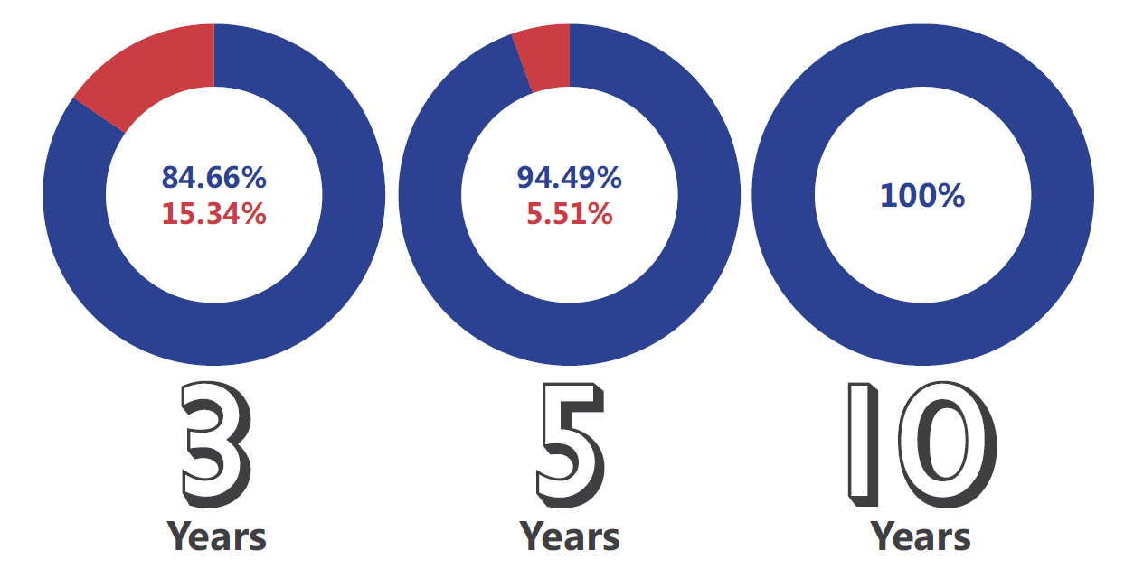
ELSS Funds vs Fixed Deposits
Historically, ELSS Funds have given more returns than Bank Fixed Deposits (Assuming 6% p.a.).
As the investment horizon increases, the chances of getting less than Fixed Deposit becomes 0%.

Slide 66


Slide 67
9. ELSS vs NSC

Slide 68

NATIONAL SAVING CERTIFICATE
Ms Pooja: Can you please explain me the concept of National savings certificate.
Mr Ajay: NSC, ie National savings certificate, is a fixed-income investment scheme backed by the government of India.
You can also save tax in this product.

Slide 69
Why is ELSS prefered over NSC
Shorter Lock in period:
Inflation beating returns:
ELSS :3 years
NSC: 5 years
ELSS: No fixed rate of interest but over a long term, it has a higher return potential.
NSC:The rate of interest is 6.8%

Slide 70
Why is ELSS prefered over NSC
4. Online mode of transaction:
Tax implication:
Rs.1
ELSS: Can purchase online through AMC or brokers.
NSC: In most cases, it is required to go to post office or national bank
ELSS: 10% Tax on returns above Rs.1 lakh
NSC: The interest earned in taxable.

Slide 71
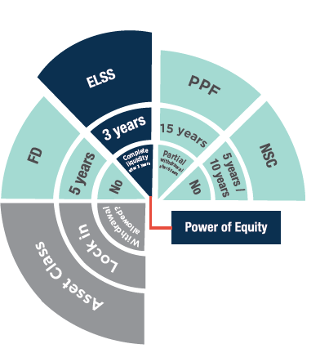
Why to Choose ELSS over other schemes?

Slide 72
Inflation adjusted returns
Ms Pooja: What is inflation adjusted return?
Mr. Ajay: In simple terms inflation adjusted return means considering the factor of inflation or how the price increase/decrease affects the purchasing value of money over time.
Over the long term, ELSS has given inflation beating returns.
Let us take an example of the Franklin India tax shield fund and compare the inflation adjusted returns with PPF and SBI tax savings fixed deposit.

Slide 75
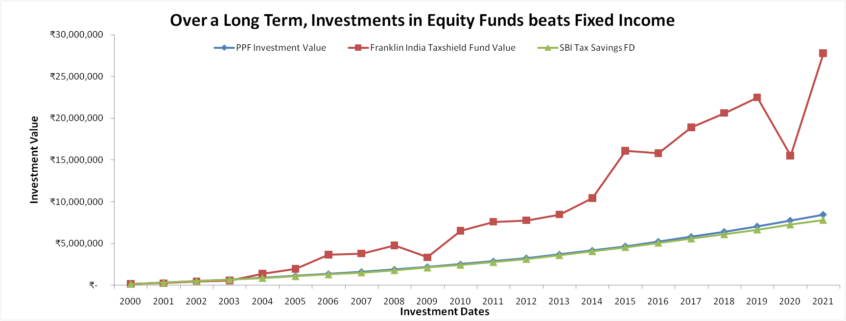

Slide 76
Investment Amount: 33 lakhs
Generates
Generates
Generates
3.60 Crores in
Franklin India Tax shield fund
88.38 lakhs
in PPF
80.55 lakhs in
FD
Return on Investment
11 times in
Franklin India Tax shield Fund
Only 2.6 times in PPF
Only 2.4 times in SBI tax savings funds

Slide 77
Inflation Adjusted Profit after tax
Rs 2.54 crore in
Franklin India Tax shield fund
Rs 9.31 lakhs in
PPF
Rs 2.25 lakhs in
SBI tax savings FD
Among all the tax saving options Franklin India tax shield fund gives maximum returns and SBI tax saving FD gives the least returns

Slide 78
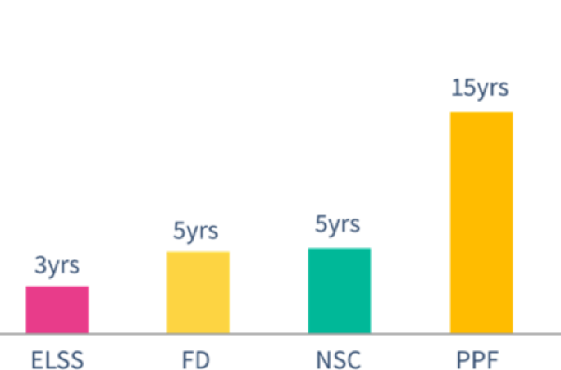

ELSS HAS THE LOWEST LOCK-IN PERIOD

Slide 79


Slide 80
10. Wealth creation under ELSS

Slide 81

WEALTH CREATION UNDER ELSS.
Mr. Ajay: ELSS should not be seen only as a source of saving tax but also as a way to create wealth.
Mr. Ajay: Let us look at the classification and numerical data considering different sections of income and how much wealth you can create through it.
For better clarification let us assume that the rate of return is at 12% compounded annually for 3 years.
The tax saved is reinvested into ELSS for better comparison.
Ms Pooja: Sure, Thank you.

Slide 82
ELSS WEALTH CREATION WHEN GROSS INCOME IS 15,00,000
Return on Investment (without 80C benefit)
12% p.a.
Return on Investment
(with 80C benefit)
22.61% p.a.

Slide 83
ELSS WEALTH CREATION WHEN GROSS INCOME IS 10,00,000
Return on Investment (without 80C benefit)
12% p.a.
Return on Investment
(with 80C benefit)
19.31% p.a.

Slide 84


Slide 85
11. Risk involved while investing in ELSS

Slide 86

Risk involved while investing in ELSS
Market risk: ELSS as a category of mutual funds invests at least 80% of their portfolio in equity and equity related instruments. Equity is subject to ups and downs, however the high return to risk ratio combined with the lock in period helps even out the market fluctuations and works in favor of long term investors.
Liquidity risk: ELSS has a lock in period of three years so it can be difficult to redeem or transfer funds before 3 years.

Slide 87
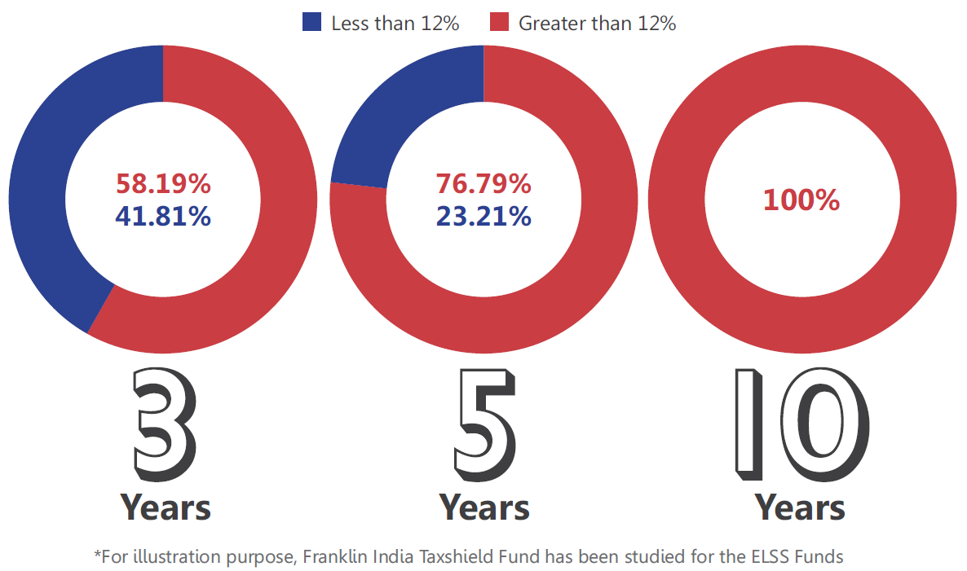
Return Potential of More than 12%
From past observations, ELSS Fund had generated more than 12% returns consistently.
If an investor would like to increase the chances of getting more than 12% returns, then they should increase their investment tenor.

Slide 88
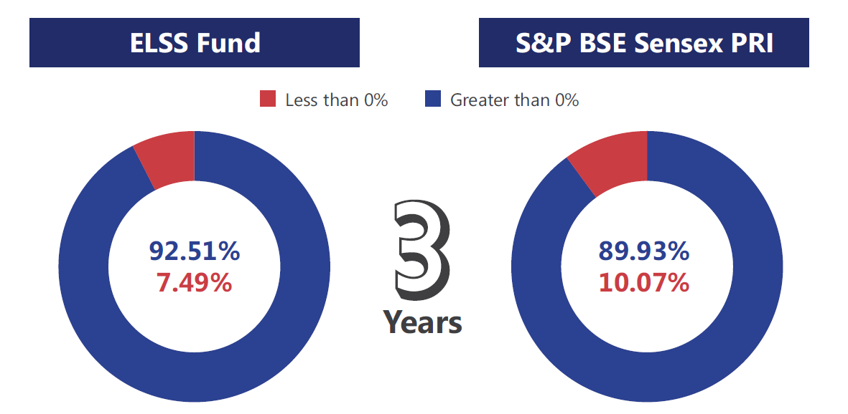
Downside Risk Diminishes Over Time
ELSS Fund has more potential to generate positive returns than SENSEX.
The percentage of time, the ELSS Fund posted positive returns over the different rolling time period.

Slide 89
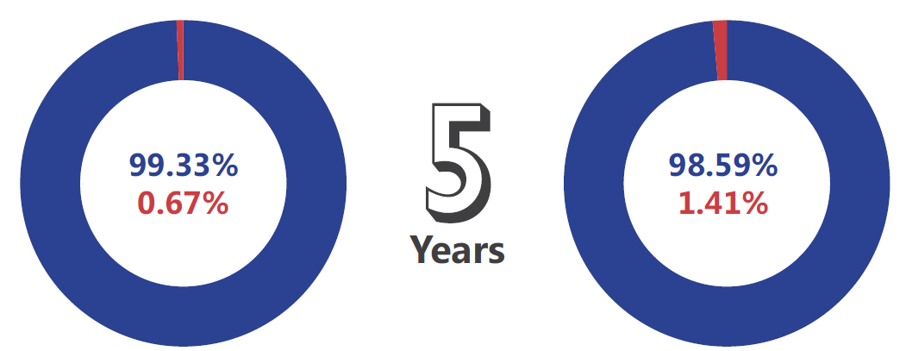
Downside Risk Diminishes Over Time
ELSS Fund has more potential to generate positive returns than SENSEX.
The percentage of time, the ELSS Fund posted positive returns over the different rolling time period.

Slide 90
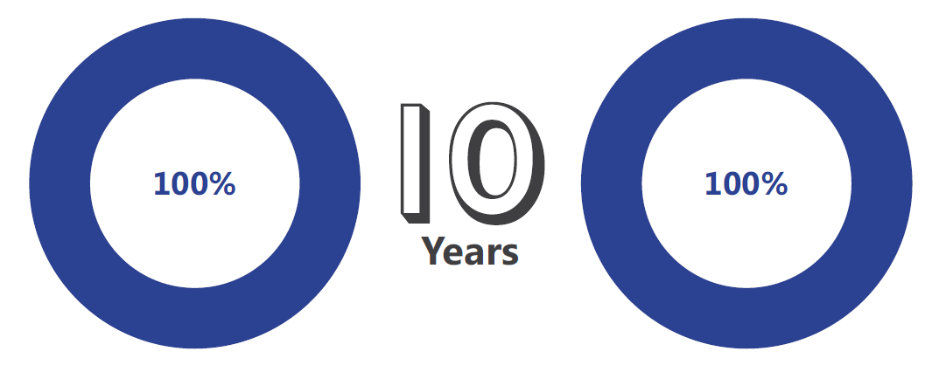
Downside Risk Diminishes Over Time
ELSS Fund has more potential to generate positive returns than SENSEX.
The percentage of time, the ELSS Fund posted positive returns over the different rolling time period.

Slide 91
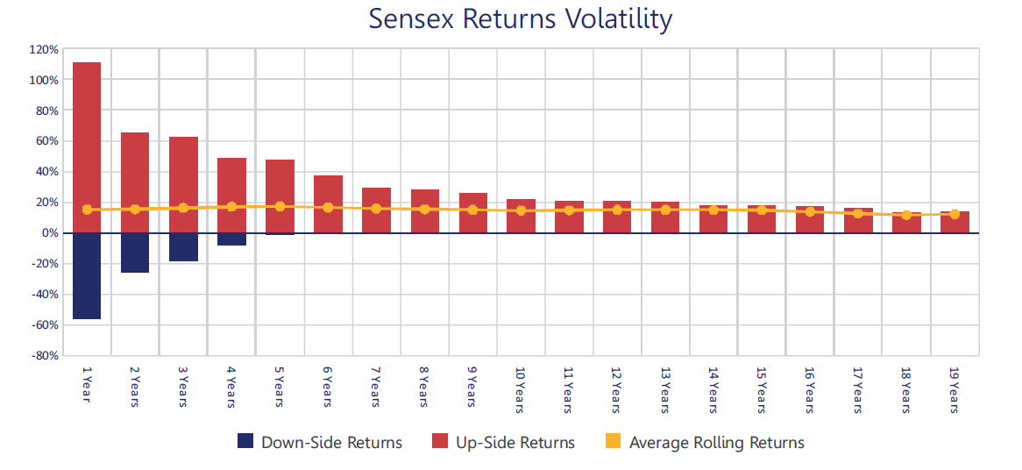
ELSS Asset Allocation & Volatility
The good feature about volatility is that in the long term it goes away.

Slide 92

ELSS Asset Allocation & Volatility
Know what you own, and know why you own it.
ELSS Funds invest more than 80% of assets in Equities, which has an excellent return potential, but of course it comes with volatility, which is a part and parcel of investing in equities.
No one can control volatility at the market level, but the investors themselves can minimize the volatility, if they follow below points:
The First is do not use news to make decisions.
The second thing to remember is that you cannot time markets effectively.
And finally it is important that you don't follow the heard.

Slide 93


Slide 94
12.ELSS Schemes Performance
and Asset Allocation

Slide 97



Slide 98


Thank You

